Slide 1


Analyzing Beer Preferences
Team Members: Rob Stewart, Shenglin Ye, Shamil Tajuddin, Xiaoran Chen

Slide 2
Questions:
What do people enjoy most about beer?
Do preferences change by beer styles?
Data Overview
Source: Data.World: BeerAdvocate
Timespan: 16 years( 1996—2012)
1.05 million reviews
104 beer styles
29,256 beers
270,174 reviews were above 4
Data Cleansing
Understanding
Deep Dive
Drop off rows which miss information
Convert timestamp to date
Checked integrity of data
Group data by overall review score
Created separate data frames
Created bar charts
Multiple linear regression
Overall ratings
American IPA
Fruit beer

Slide 3
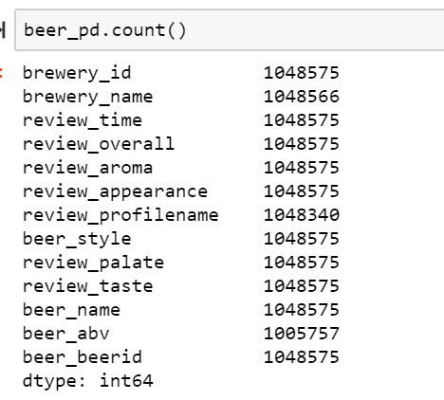
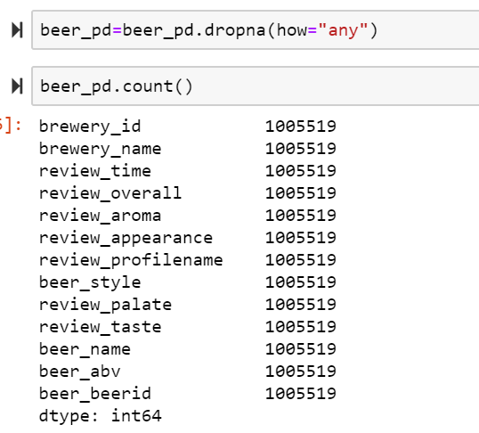
Data Cleansing
Before After

Slide 4
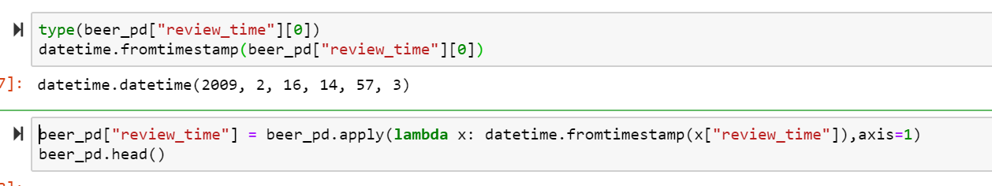
Data Cleansing
Timestamp to Date

Slide 5
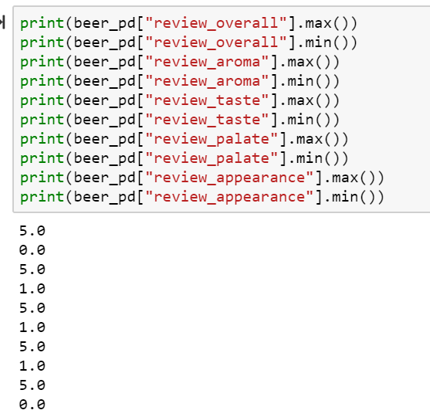
Data Cleansing
Data Integrity Check

Slide 6
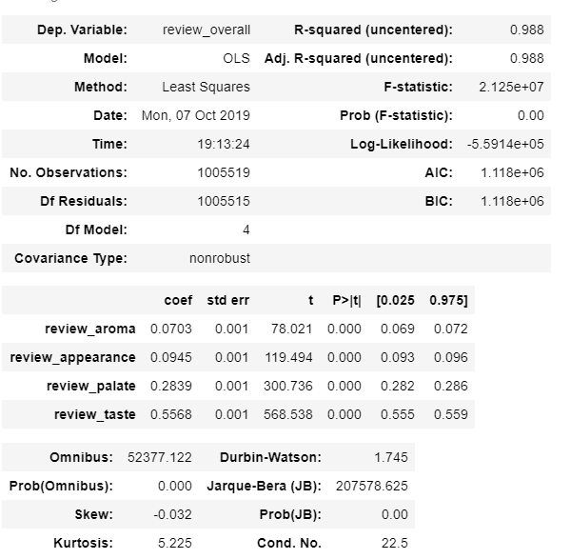
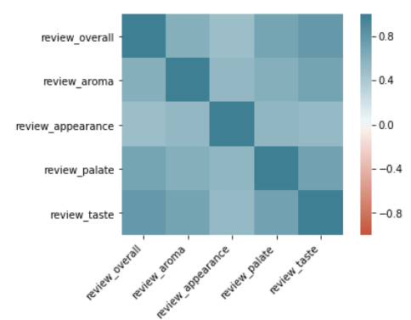
Deep Dive
Regression on full population

Slide 7
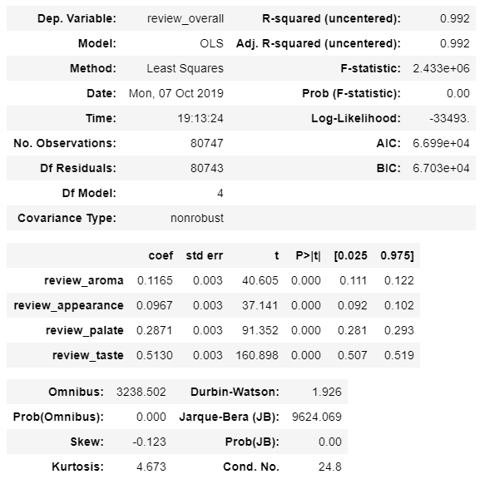
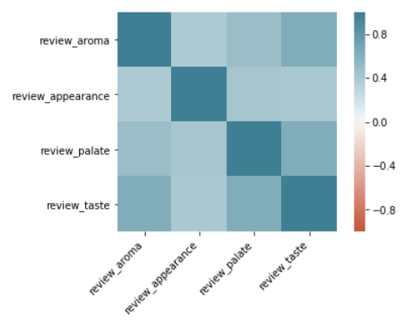

Slide 8
